Slide 1
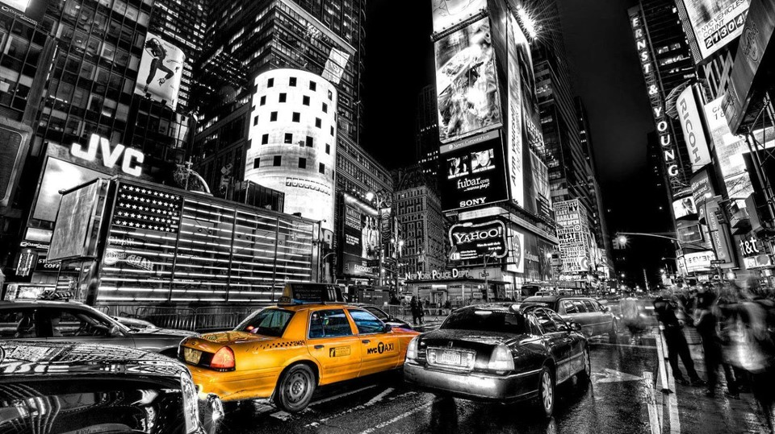
DO WEATHER CONDITIONS INFLUENCE YELLOW TAXI TIPS IN NEW YORK CITY (2021)?
Notes:
Today I’m going to be exploring if weather conditions influence yellow taxi tips in New York City. But first a bit of background…

Slide 2
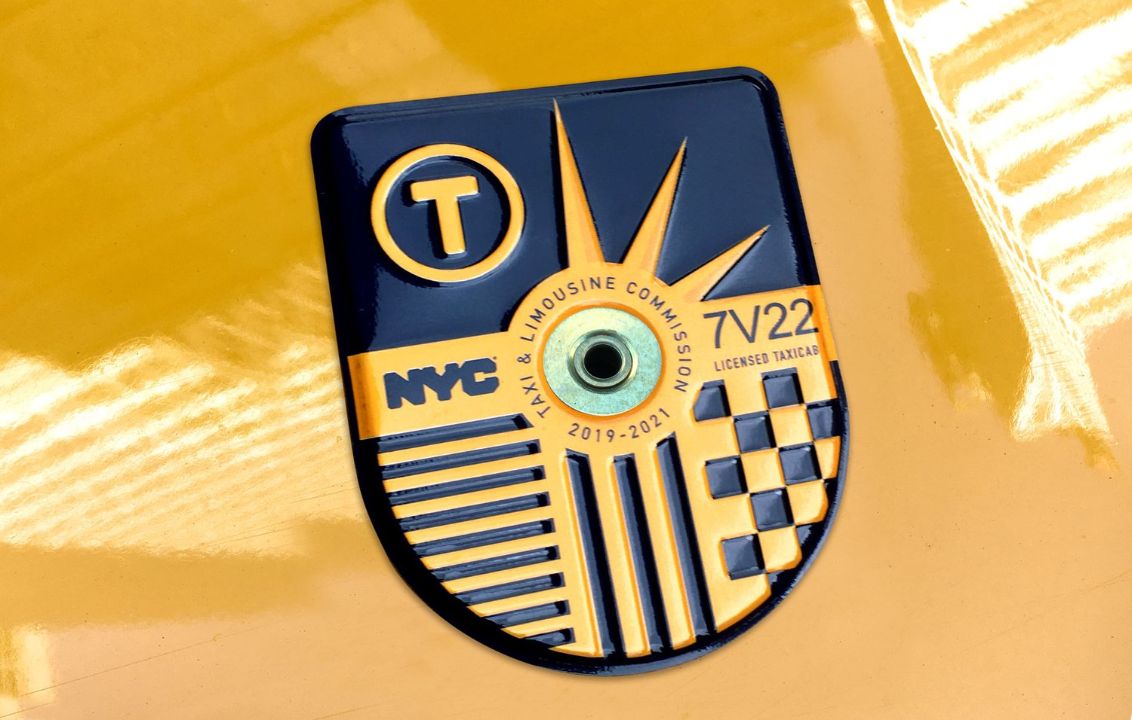
BACKGROUND
In 1937, New York City (NYC) government created the taxi cab medallion system.
By law, there are 13,587 yellow taxis in NYC and each taxi must have a medallion affixed to it.
NYC rarely creates new ones. This regulation helps to keep the supply of cabs down, and the cab companies in business.
The Taxi and Limousine Commission (TLC)
Regulates how much a yellow cab can charge per mile or per minute.
Determines a yellow cab company's leasing fees for drivers.
Monitors routes taken by the drivers (to ensure they are not artificially inflating the price)
And more…
Notes:
Because of the Great Depression – In the 1930’s thousands of unemployed men became NYC cab drivers.
Almost overnight, the number of cabs on the road exploded, suddenly supply was far greater than demand.
The cab industry was destined for destruction, so the government stepped in to regulate it.
One of the things they did is to create the taxi medallion system. The number of medallions is closely regulated by the city government.
But that’s not all the government does to keep the taxi industry in check, it also regulates the following things such as how much cabs can charge and what routes they can take.

Slide 3
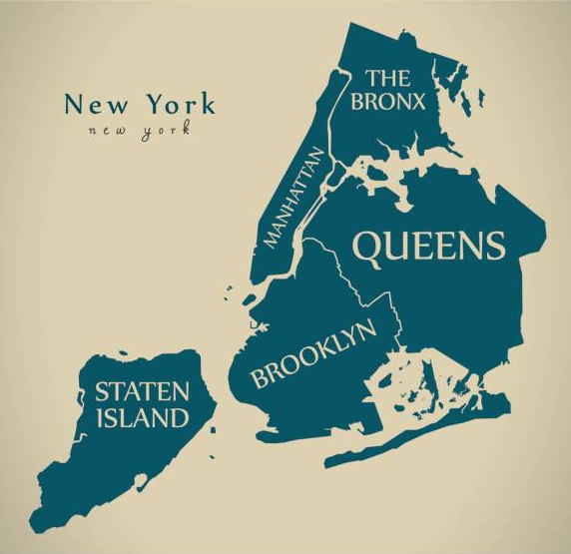
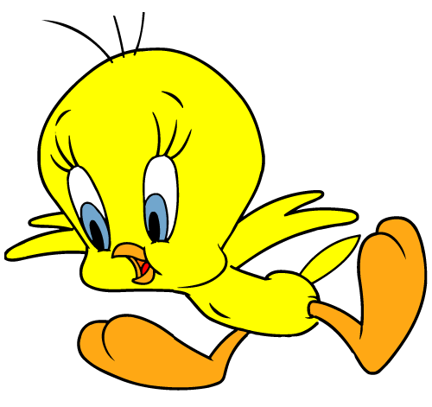
BACKGROUND
Most yellow cabs are concentrated around Manhattan.
Taxi drivers don't usually want to leave Manhattan to take people to Brooklyn, Queens, or the Bronx.
New York City
Boroughs
If a taxi driver asks you through the window where you want to go before you are in the taxi, they might say no and drive away!
If you flap your arms like a bird the cab driver will know you want to go to the airport!
Notes:
Most yellow cabs are located in Manhattan and they usually don’t like to leave and go to other areas.
They usually ask you where you want to go before you get in and if its too far they just drive off.
However, taxi regulations require the driver to take you to wherever you want to go, even if it’s inconvenient for them.
So if your smart, you would actually get in and then tell the driver where you want to go.
Unless your going to the airport then you have to flap your arms like a bird!

Slide 4
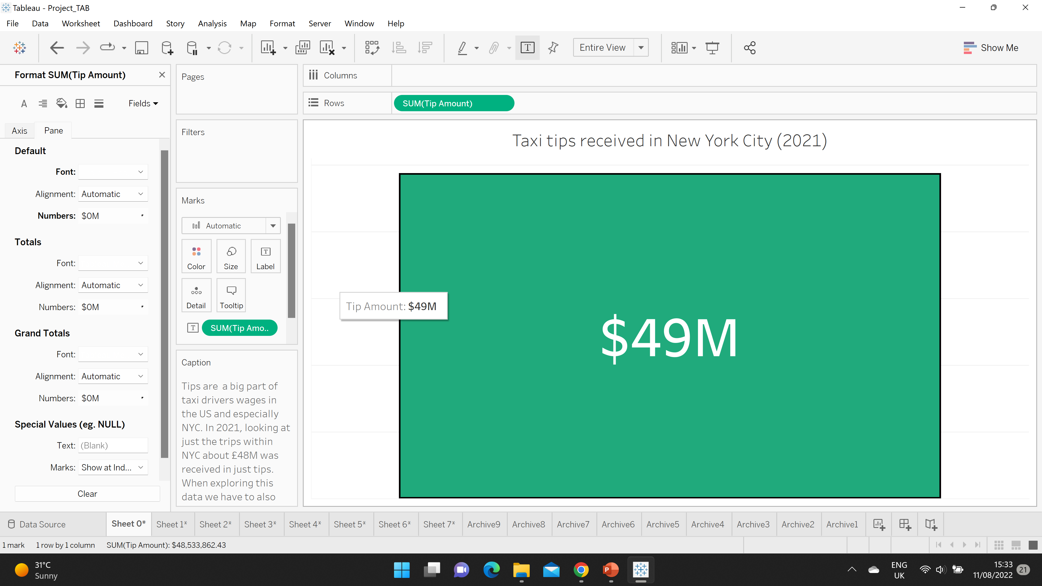
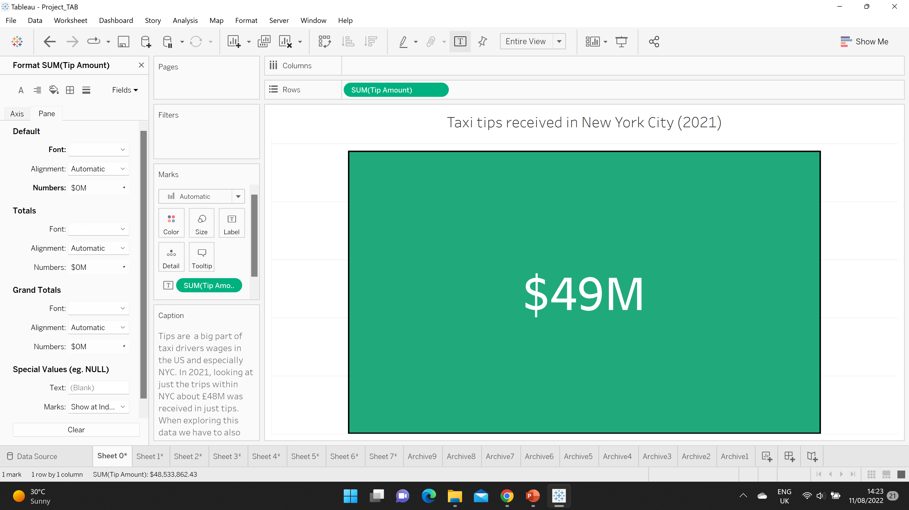
HOW DID COVID-19 AFFECT TIPS IN 2021
Factors to consider
Covid-19 (Social distancing, remote working)
Competition from companies like Uber and Lyft
Less active yellow taxi drivers
Medallion price crash
(Card payment only)
Notes:
So 2021, was an awful year for yellow cab drivers because of Covid-19 and around $49M dollars were received in tips, which was much less compared to pre-Covid years.
We have to keep in mind that at beginning of 2021, many yellow cab drivers decided to stop driving because of Covid-19. There were less people travelling and more people working remotely.
Because the government regulates a lot of things when it comes to how much drivers can earn, I decided to explore something that wasn’t really regulated which is tips…

Slide 5
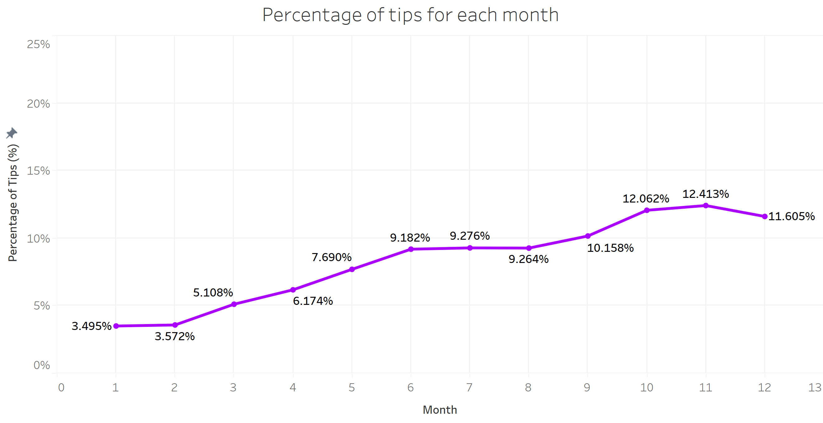
OVERVIEW OF TIPS (2021)
Notes:
So we can see that the percentage of tips is quite low during the first few month’s of the year and Covid-19 might have something to do with that.
But the tips started picking up during the summer months and over the festive season at the end of the year.
Why did the tips increase? I thought maybe weather might play a role, so I decided to explore weather conditions for these trips…

Slide 6
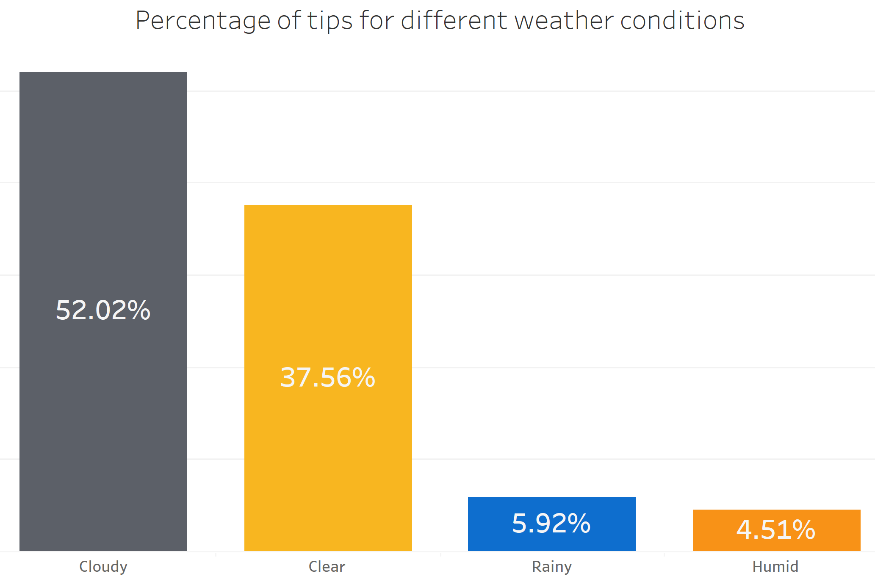
WEATHER CONDITIONS
Notes:
Here we can see that more tips were earned during clear and cloudy weather, surprisingly people don’t tend to tip as much in rainy and humid weather.
So I thought to myself why is that? Could it be related to temperature? So I decided to explore temperature.

Slide 7
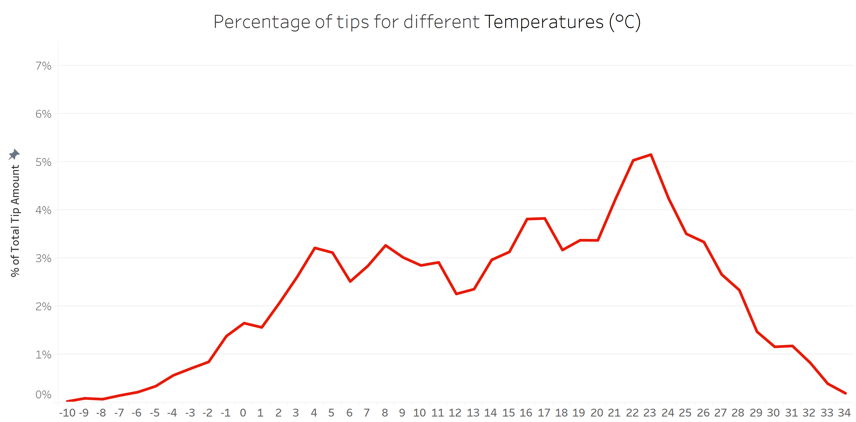
TEMPERATURE
Notes:
I found that negative temperatures have a low percentage of tips. And the majority of tips are received when the temperature is warm.
The optimum temperature is around 22-24 degrees. From this point the tips starts rapidly decreasing when the temperature gets too hot.
So again, I asked myself why is that? I decided maybe looking at weather conditions and average temperature might give me a clue…

Slide 8
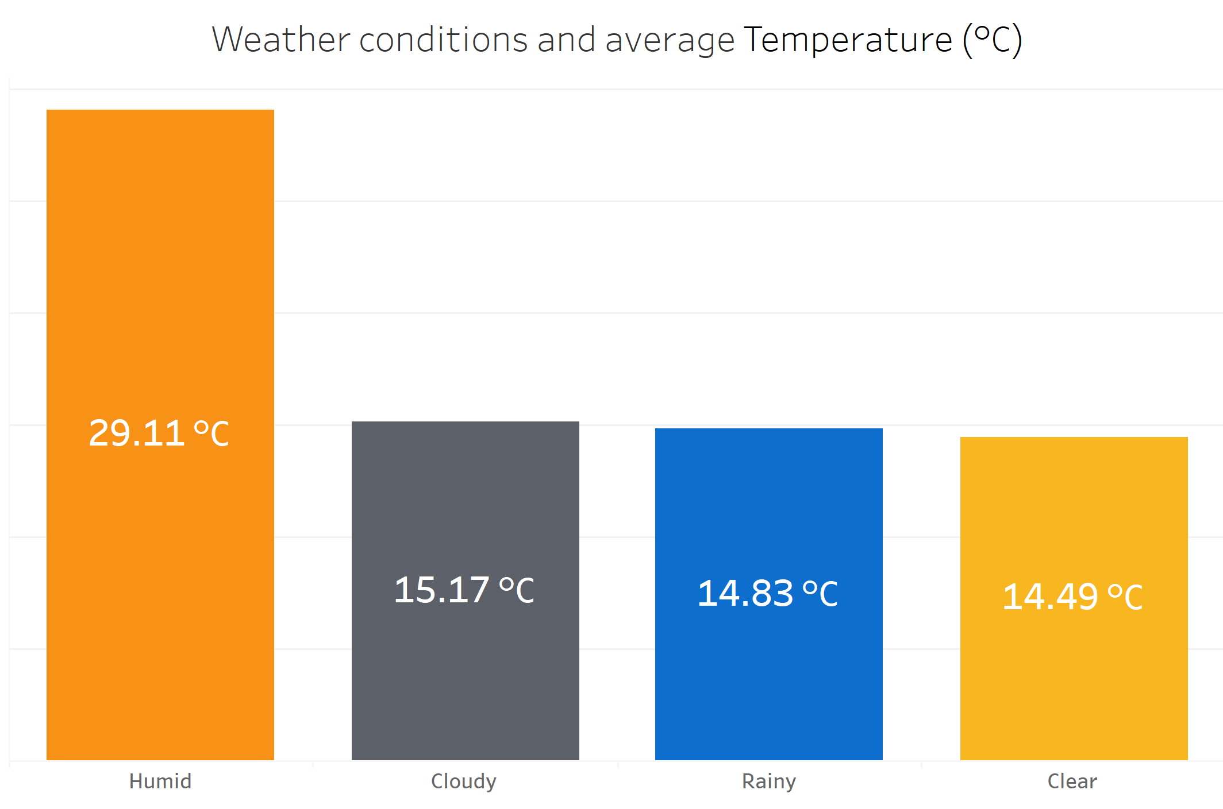
WEATHER AND AVERAGE TEMPERATURE
Notes:
The average temperature is higher during humid weather so it makes sense why people don’t tip when the weather is too hot.
I wanted to know if people travel short or long distances during warm weather, like going to the beach for example. There’s lots of beaches outside of Manhattan that are around NYC.
Maybe because of the drop in customers during Covid-19, cabs drivers were more willing to travel longer distances?

Slide 9
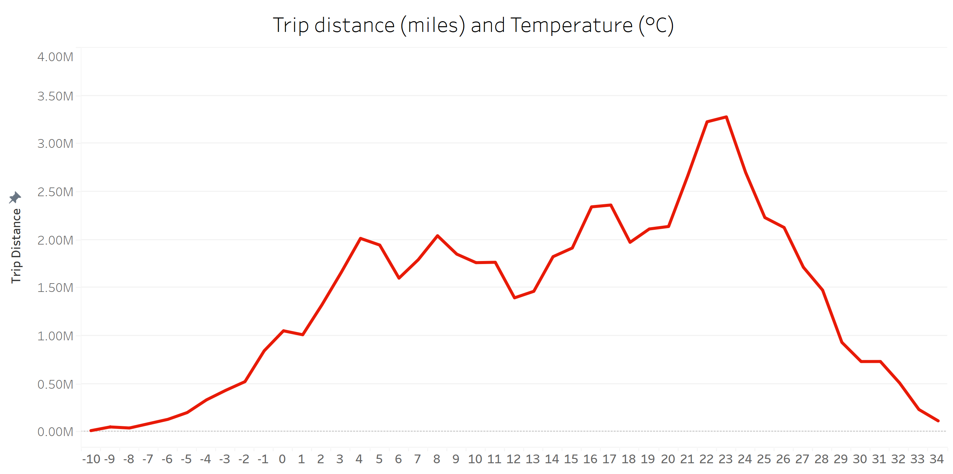
TRIP DISTANCE AND TEMPERATURE
Notes:
We can see that people travel longer distances when the temperatures is warm.
Again, the optimum temperature is around 22-24 degrees, but when it gets too hot the distance starts to rapidly decrease.
Next, I wanted to explore if the hour of day makes any difference.

Slide 10
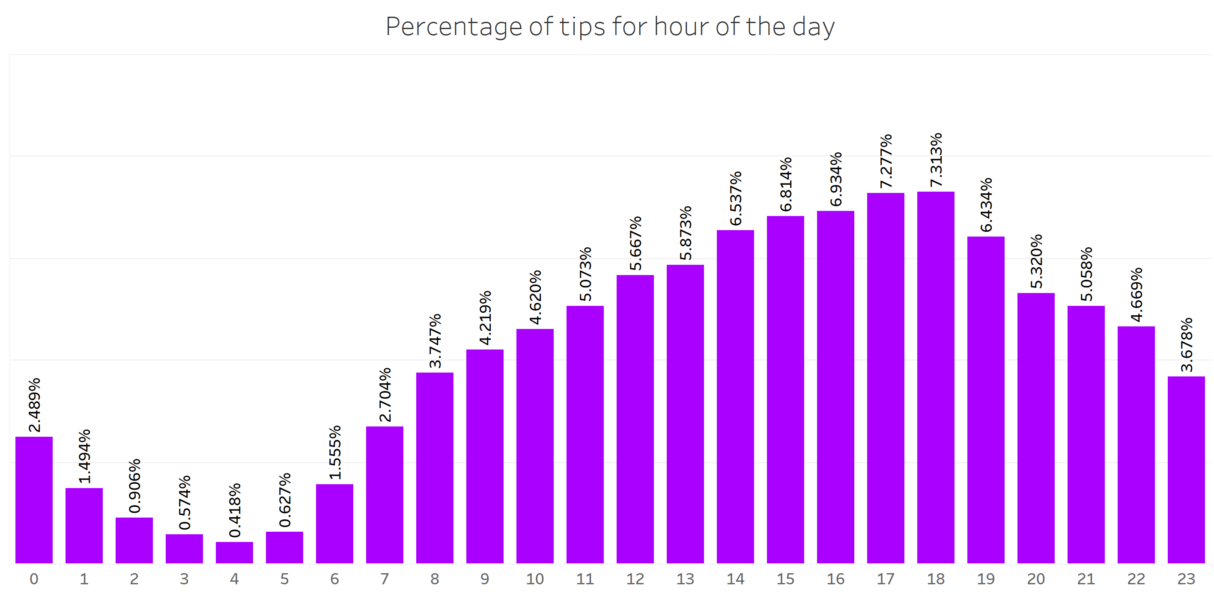
HOUR OF DAY AND TIPS
Notes:
Yellow taxi’s are available 24 hours and we can see that the percentage of tips is quite low, during the early hours of morning.
The best time to get tips is during the evening peak time when people are travelling home from work and the tips start decreasing during the night.
By visualizing I could see some features had a relationship with tips so I decided to use some of them in my model.

Slide 11

RANDOM FOREST (FIRST MODEL)
Purpose of model: To see if weather conditions along with selected features that are readily available to the cab driver had an effect on if drivers got a tip or not.
Features
Hour, Day of Week, Month, Passenger Count, Summary (Weather Condition), Humidity, Windspeed, UV index, Visibility and Temperature
Precision for tip =77%
Precision – What percent of your predictions were correct?
Target (Did the driver get a tip?)
No
Yes
Notes:
The purpose of the model was…
I chose these features and the target is if they got a tip or not.
It was interesting to see that that our model has a decent precision for getting a tip.
YES - which means everytime it predicts that the driver will get a tip, there is a 77% chance the driver will actually the tip.
----------------------------------------------
Precision – What percent of your predictions were correct? TP/(TP + FP). Accuracy of positive predictions.
NO – which means everytime it predicts that the driver will not get a tip, there is a 29% chance the driver will actually not get the tip.
----------------------------------------------
Recall – What percent of the positive cases did you catch? TP/(TP+FN). Fraction of positives that were correctly identified.
NO – Out of all the drivers that did not get a tip our model could correctly identify 53% of them.
YES - Out of all the drivers that got a tip our model could correctly identify 54% of them.

Slide 12
RANDOM FOREST (SECOND MODEL)
Purpose of model: To see if weather conditions along with selected features that are readily available to the cab driver had an effect on drivers getting tips over 15%.
Features
Hour, Day of Week, Month, Passenger Count, Summary (Weather Condition), Humidity, Windspeed, UV index, Visibility and Temperature
Recall for tip over 15% =96%
Recall – What percent of the positive cases did you catch?
Target (Was the tip more than 15%?)
No
Yes
Notes:
Next I created another model because I wanted to see…
Again the features remain the same, but now my target has changed.
It was interesting to see that the Recall for tips >15% is actually good.
YES - This means that out of all the drivers that have got more than 15% tips our model could correctly identify 96% of them.
----------------------------------------------
Recall – What percent of the positive cases did you catch? TP/(TP+FN). Fraction of positives that were correctly identified.
NO – Out of all the drivers that did not get a tip greater than 15% our model could correctly identify 5% of them.
----------------------------------------------
Precision – What percent of your predictions were correct? TP/(TP + FP). Accuracy of positive predictions.
NO – which means everytime it predicts that the driver did not get a tip greater 15%, there is a 51% chance the driver will actually not get a tip greater than 15%.
YES - which means everytime it predicts that the driver will get a tip greater than 15%, there is a 56% chance the driver will actually get a tip greater than 56%.

Slide 13

CONCLUSIONS
NO!
THE WEATHER FEATURES ARE NOT IMPORTANT WHEN PREDICTING TIPS MORE THAN 15%!
The most important feature is actually
HOUR OF DAY
Notes:
After spending a week analysing a dataset that was over 20 million rows… and doing a third model where I removed all the weather features I found out that….
All the scores were almost exactly the same as my second model.
The most important feature is hour of day. Looking back, if I had extra time, I would have done some things differently and make different decisions.
I would have also looked at more data from before Covid-19 hit.
But what I found really interesting was the price of the NYC medallion.
--------------------------------
Permutation Importance

Slide 14
THINGS I WOULD LIKE TO EXPLORE
Analysing the value of the NYC taxi Medallion over the years
1962 -> $25,000
2005 -> $325,000
2013 -> over $1M
Uber and Lyft captured some of the market and the price starts crashing
2021/2022 -> less than £100,000
Many cab drivers who took out loans have been forced to declare bankruptcy.
Deal reached with government to reduce debt to $170K!
Notes:
I found out there was a year on year increase in the price. And people could effectively retire and live a good life if they managed to sell their Medallion before 2013.
It then started to crash this was when Uber and Lyft started gaining traction in the market. And because of Covid it’s reached an all time low.
Since many cab drivers took out loans in order to afford medallions when price was really high, many were forced to declare bankruptcy.
An agreement was made last year between the government and bank, to reduce their debt to $170K thousand. It would be interesting to see what the price will be like in the coming years.

Slide 15
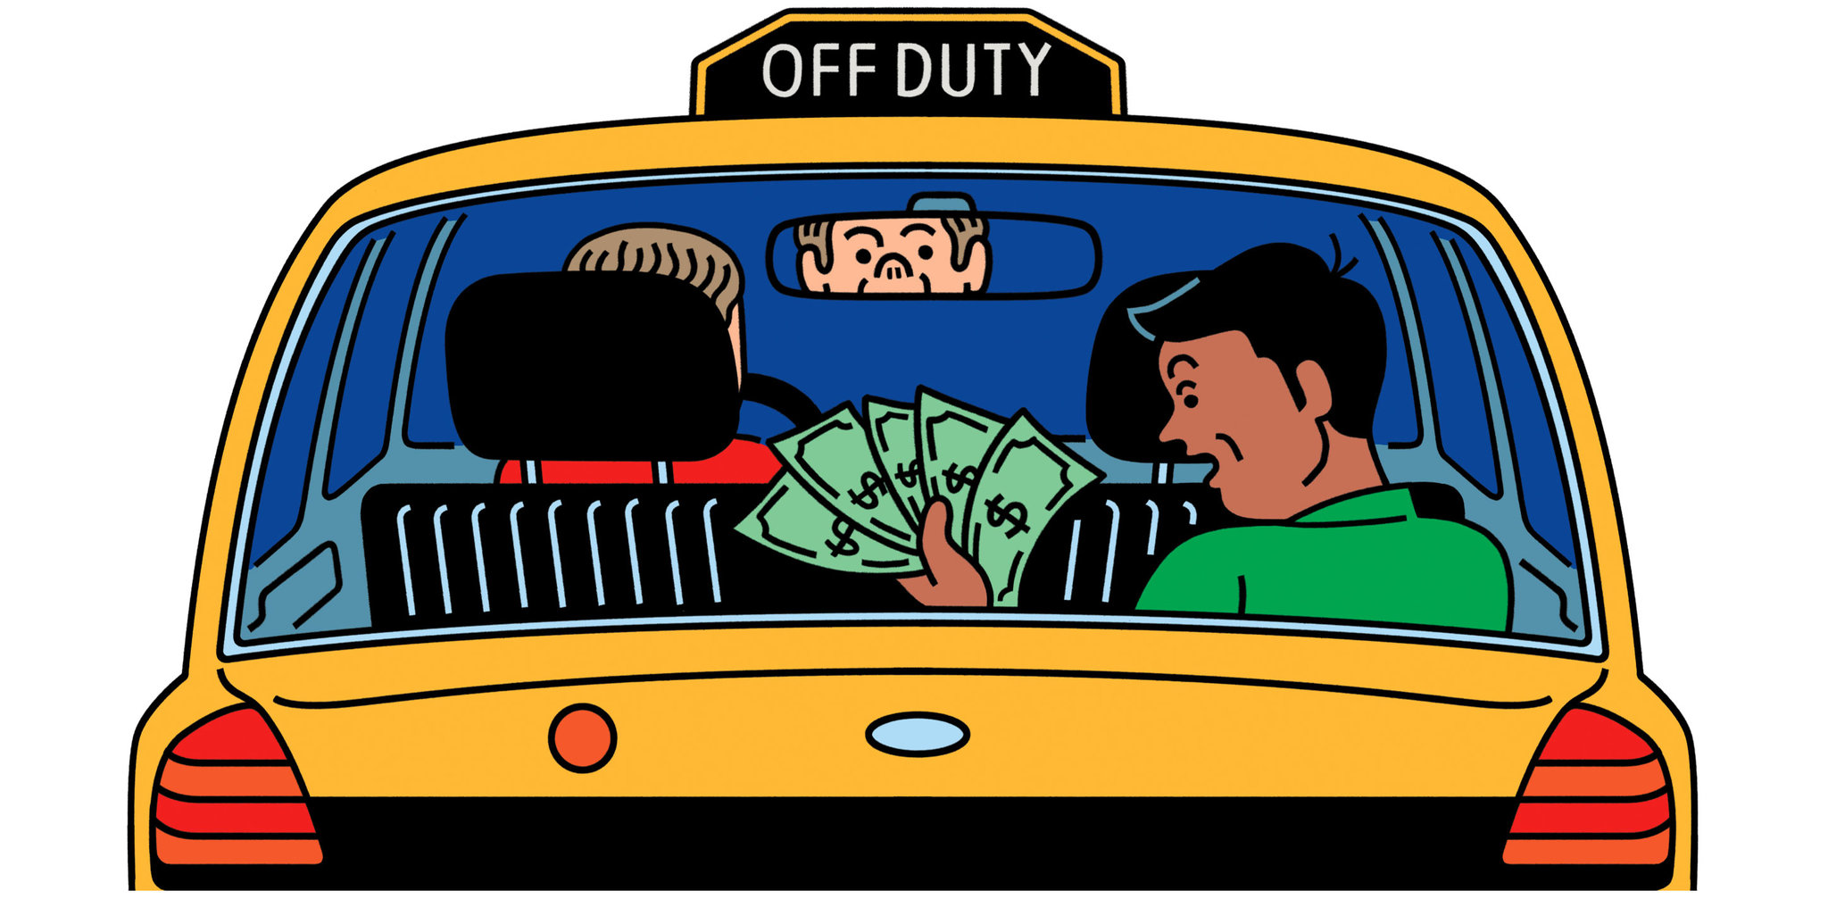
THE END
Presented by Asha Makwana
THANK YOU FOR LISTENING!
THOUGHTS?
COMMENTS?
Sources:
https://darksky.net/dev/docs
https://dev.socrata.com/foundry/data.cityofnewyork.us/m6nq-qud6
https://media.istockphoto.com/vectors/modern-city-map-new-york-city-of-the-usa-with-boroughs-and-titles-vector-id849741258?k=20&m=849741258&s=612x612&w=0&h=S0UN94Je4ulHaHb2aaGPZowqRLW6zyw2H6K-RW8CyRU=

